Slide 1
BALDWIN FAMILY OFFICE LLC
TAX MITIGATION PLANNING
FOR THE TWENTY TWENTIES
HELPING CLIENTS KEEP THE MONEY THEY HAVE

Slide 2
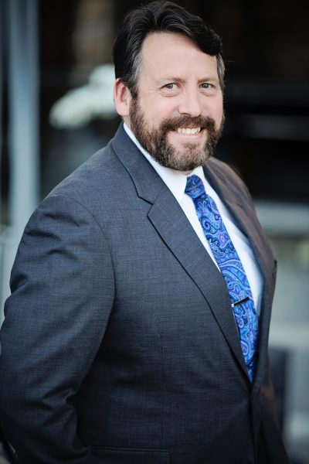
Eric T. Meck
Managing Director, CFO & Family Office Controller
Eric Meck has more than thirty years of family office accounting and tax experience. He handles all aspects of individual, family, corporation and foundation financial matters. Eric holds a B.S. in Accounting from Kutztown University and is a member of the Institute of Certified Management Accountants, the National Association of Tax Professionals and National Society of Tax Professionals.

Slide 3
Richard K May
Princeton University graduate
University of Michigan MBA
Started RKM Advisors, a Fee only Advisory Firm in 1980
Founded West Chester LLC, a Venture Firm in 2007
Co Founder of Uptown! Entertainment Alliance 2011
Currently Managing Director RKM A Baldwin Company
42 years of tax and investment experience
14 years of experience investing in local projects

Slide 4
TAX REALITY 2022
Currently at Historic Lows
Tax Bracket Creep
New Taxes Coming from all Directions
Issues with a Dysfunctional Tax System

Slide 5
DIFFERENT VIEW OF CURRENT RATES (MARRIED FILING JOINT)
FIRST $110,000 OF INCOME TAX $9500 OR 8.6%
NEXT $260,000 OF INCOME TAX $60,000 OR 23%
NEXT $300,000 OF INCOME TAX $100,000 OR 33%
ABOVE $670,000 TAX RATE OF 37%
FICA/MEDICARE TAX 7.65% OF FIRST $147,000 OF WAGES
MEDICARE TAX 1.45% ONLY ABOVE THAT LEVEL
ON NET INV INCOME 3.8% WHEN INCOME ABOVE $250,000

Slide 6
TRADITIONAL APPROACHES
Defer Income and Accelerate Deductions
Bunch Deductions
LLC’s and other legal and tax savvy entities

Slide 7
PROGRESSIVE PLANNING
Roth Conversions
Charitable Trusts
Ownership of Assets
Attribution of Income

Slide 8
PLANNING FOR A NEW PROGRESSIVE ERA
The Build Back Better Bill and Tax Rates
Inevitable Tax Increases Over Time
Proliferation of Provisions
Corporate Rate of 25% Provides Little Tax Revenue
Go Where The Money Is…Assault On Wealth

Slide 9
BRIEF HISTORY OF WEALTH IN THE U.S.
18th Century to 1860
1865-1900
Progressive Era
1980-2022

Slide 10
MITIGATING TAXES ON WEALTH
New Progressive Era meets the Digital Era
Beware of a More Functional IRS
Use of Appropriate Entities and Titling of Assets
Where to Locate Different Types of Assets

